Slide 1
Blackstone Heritage Corridor Community Survey
Survey Results as of July 12, 2021

Slide 2
Insights
456 Responses as of July 12, 2021
100% Completion Rate
Typical Time Spent – 7m 58s
Most Skipped Question: Question 13
171 Respondents live in a Rhode Island Corridor Community
268 Respondents live in a Massachusetts Corridor Community
71 Respondents live outside of the Corridor Communities

Slide 3
Question 1
Answered: 455
Skipped: 1

Slide 4
Question 2
Answered: 359
Skipped: 97

Slide 5
Question 3
Answered: 218
Skipped: 238

Slide 6
Where do respondents currently reside?

Slide 7
Question 4
Answered: 127
Skipped: 329

Slide 8
Question 5
Answered: 285
Skipped: 171

Slide 9
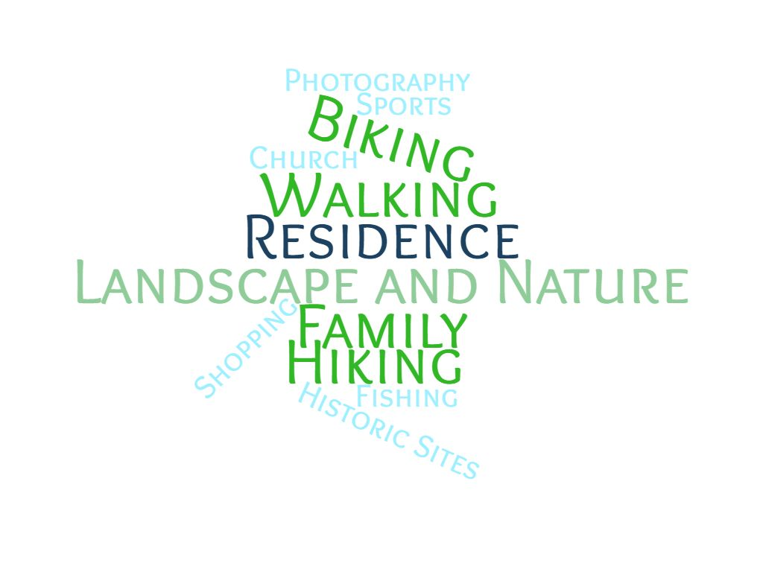
Respondents also travelled to the Corridor for…

Slide 10
Question 6
Answered: 450
Skipped: 6

Slide 11
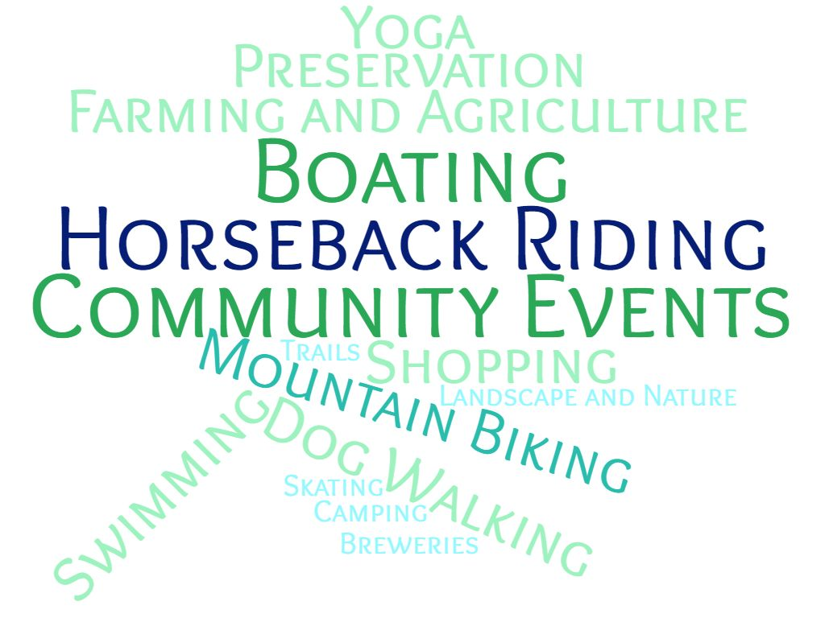
Respondents also enjoy…

Slide 12
Question 7
Answered: 439
Skipped: 17

Slide 13
Question 8
Answered: 451
Skipped: 5

Slide 14
Question 9
Answered: 453
Skipped: 3

Slide 15
Question 10
Answered: 453
Skipped: 3

Slide 16
Question 11
Answered: 420
Skipped: 36

Slide 17
Question 12
Answered: 152
Skipped: 304

Slide 18
Respondents were also interested in volunteering in these areas…
Preservation and clean ups
Historic tour guide
UK Ambassador
Developing local history curriculum
Freelance writing and marketing
Fundraising
Clerical
Photography
Fishing and hunting courses

Slide 19
Question 13
Would you like to provide any additional comments or feedback, or is there anything else you would like to know about the Heritage Corridor?
99 responses
357 skipped
Highlights
Youth engagement
Expanding hiking, biking, and walking opportunities
Water resource protection
Historic preservation and education

Slide 20
Prize Drawing
186 respondents entered their emails for the prize drawing
270 respondents skipped the prize drawing

Slide 21
QUESTIONS?

